Slide 1

AN AI-POWERED SYSTEM FOR CORRELATING PHYSICAL ACTIVITY AND SUBJECTIVE MENTAL WELL-BEING
PASET697 Project Work Review- II
Presented by
Harsh Pratap Singh (25MCA1027)
Masters of Computer Applications
Under the Guidance of
Dr. Saranya G
Assistant professor-Senior Grade
School of Computer Science and Engineering
Vellore Institute of Technology, Chennai.

Slide 2
CONTENTS
ABSTRACT
INTRODUCTION
LITERATURE SURVEY
RESEARCH GAPS
OBJECTIVES
MODULE IDENTIFICATION
SYSTEM ARCHITECTURE
DEVELOPMENT & INTEGRATION
PROTOTYPE / RESEARCH FRAMEWORK
OUTCOME
RESULTS
TIMELINE / GANTT CHART
REFERENCES

Slide 3
1.ABSTRACT
This project presents MindfulMomentum, an n-of-1 mobile health application designed to proactively correlate quantitative physiological data with qualitative psychological states. To shift from generic health tracking to highly personalized wellness, the system implements a closed-loop architecture featuring:
Data Acquisition: Securely ingests objective physical metrics (step count, active calories, and sleep duration) via the Android Health Connect API, while simultaneously capturing subjective mental well-being through unstructured daily journal entries.
NLP Pipeline: Utilizes an optimized NLTK VADER engine with sentence-level sentiment scoring to process text efficiently without the compute overhead of an LLM, actively preventing "sentiment dilution."
Machine Learning Engine: Fuses these disparate data streams within a Python FastAPI backend to train a personalized Random Forest classifier for each unique user.
Defensive Architecture: Employs Dynamic SMOTE to correct class imbalance and uses defensive programming to gracefully manage sparse datasets.
Ultimately, the system transcends generic advice by delivering data-backed, individualized insights (e.g., identifying sleep as the #1 driver for a positive mood) directly to the user through a modern React Native interface.

Slide 4
2. INTRODUCTION
The Problem (Data Silos): Currently, personal health data is highly disconnected. Physical metrics are tracked by wearables, while mental well-being is isolated in journaling apps, preventing users from seeing how their lifestyle impacts their mood.
The Motivation: To shift the digital health paradigm from reactive monitoring to proactive, personalized wellness.
The Primary Objective: To build a unified, closed-loop system that securely bridges physical IoT sensor data with qualitative emotional data.
The Methodology: By applying Artificial Intelligence—specifically Natural Language Processing (NLP) and n-of-1 Machine Learning—the system aims to uncover hidden, individualized correlations between a user's physical activity and their subjective mental well-being.

Slide 5
3.LITERATURE SURVEY
S.No | Article Title | Authors & Year | Techniques Used | Key Findings | Limitations
1 | MyBehavior: A System for Long-Term Personalized Health Coaching | Rabbi, M. et al. (2015) | N-of-1 statistical modeling (Vector Autoregression - VAR), Correlation analysis | A pioneering system in personalized, n-of-1 health coaching. It's one of the first to build a personalized model for each user instead of a general one. | The self-reports are structured (e.g., "Mood: 1-5"), not unstructured journals. It does not use NLP to analyze the context or themes of a user's day, which is a key part of my project's novelty.
2 | VADER: A Parsimonious Rule-based Model for Sentiment Analysis of Social Media Text | Hutto, C. J., & Gilbert, E. (2014) | Rule-based, lexicon-based (VADER) | High accuracy on informal text (e.g., journals). Fast, lightweight, and doesn't require training data. | Lacks deep contextual understanding (e.g., sarcasm) that larger models might capture; provides a score, but not deeper themes.
3 | n-of-1-path: a path-analysis approach for finding personalized (n-of-1) health effects from time-series data | M. C. et al. (2019) | Path Analysis, Statistical modeling | Proposes a specific, advanced method for finding personalized effects, which is exactly what my project aims to do. | Highly statistical and complex, but it proves the need for "n-of-1" models.
4 | Multimodal Machine Learning in Mental Health: A Survey of Data, Algorithms, and Challenges | C. J. et al. (2024) | Learning in Mental Health: A Survey of Data, Algorithms, and Challenges Transformers, GNNs, Hybrid Fusion | Catalogs public datasets and fusion strategies. Confirms MML yields higher accuracy than any single channel alone. | Highlights fragmented data, privacy, and lack of longitudinal, "in-the-wild" benchmarks as major open challenges.

Slide 6
LITERATURE SURVEY (CONTD..,)
S.No | Article Title | Authors & Year | Techniques Used | Key Findings | Limitations
5 | A Multi-Modal Approach to Depression Detection using Speech, Activity, and Text | S. B. et al. (2024) | Random Forest, SVM, Deep Learning | Fusion of all three modes achieved significantly higher accuracy (over 85%) than any single data mode alone. | Focus is on clinical diagnosis (depression) for a doctor, not on proactive wellness insights for a general user.
6 | StudentLife: Assessing Mental Health, Academic Performance and Behavioral Trends of College Students using Smartphones | Wang, R. et al. (2014) | Correlation analysis, Decision Trees | Successfully correlated sensor data with GPA and depression scores. A landmark paper in passive sensing. | The insights were for the researchers, not the students. The system did not provide a personalized feedback loop.
7 | Understanding User Perceptions of Personalized Feedback in Digital Health Tools | C. A. G. et al. (2025) | Thematic Analysis | Finds that users value adaptive, empathetic, and contextually relevant feedback. Trust is a key factor. | This paper explains how the feedback should be, but doesn't build the AI system that generates it. This justifies your "Insight Generation Layer."
8 | EMO Diary: Daily Diary with Sentiment Analysis | B, R. S. et al. (2025) | NLP, ML Classification | A practical implementation of a "smart journal" for personal well-being. | The system analyzes the journal in isolation. It is not fused with any physiological or activity sensor data.

Slide 7
LITERATURE SURVEY (CONTD..,)
S.No | Article Title | Authors & Year | Techniques Used | Key Findings | Limitations
9 | Journaling for mental health: A review of the benefits and the role of technology | Krafft, P. M., & El-Nasr, M. S. (2018) | N/A | Confirms journaling is clinically effective. Suggests AI can help by prompting users or identifying themes. | Most "smart journals" only offer prompts or basic sentiment. They do not correlate the journal with the user's physical life (activity/sleep).
10 | Wearable sensors for monitoring mental health: A systematic review | He, L. et al. (2020) | N/A | Comprehensive overview of which sensors map to which conditions (e.g., HRV to stress). | Highlights that most studies are observational; very few systems use this data for a real-time, actionable feedback loop for the user.

Slide 8
4. RESEARCH GAPS
The Personalization Gap (n-of-1): Most systems analyze population-level data; few provide individual-specific correlation models.
The Integration Gap: Commercial systems silo wearable activity data and mental health journaling.
The Actionability Gap: Research often ends at statistical findings without providing a "closed-loop" actionable feedback UI for the end-user

Slide 9
5. OBJECTIVES
Develop a unified React Native mobile app integrating subjective journals with objective Health Connect data.
Implement an NLP sentiment model (VADER) to accurately quantify emotional valence from unstructured text.
Apply an n-of-1 Machine Learning correlation model (Random Forest) to rank the personalized impact of physical metrics on mood.
Create a transparent feedback loop to present these insights in an actionable format.

Slide 10
6. MODULE IDENTIFICATION
Module 1: Data Acquisition Layer (Frontend): React Native UI. Responsible for pulling Health Connect metrics (Steps, Sleep) and capturing unstructured journal text.
Module 2: NLP Engine (Backend): Utilizes NLTK VADER. Segments paragraphs, performs sentence-level sentiment scoring, and extracts POS (Part-of-Speech) themes.
Module 3: ML Correlation Engine: Fuses data by date. Uses a Random Forest Classifier with Dynamic SMOTE to determine "Top Feature" importances.
Module 4: Insight Generation & Presentation: Evaluates ML output and serves a formatted JSON payload back to the mobile Insights Dashboard.

Slide 11
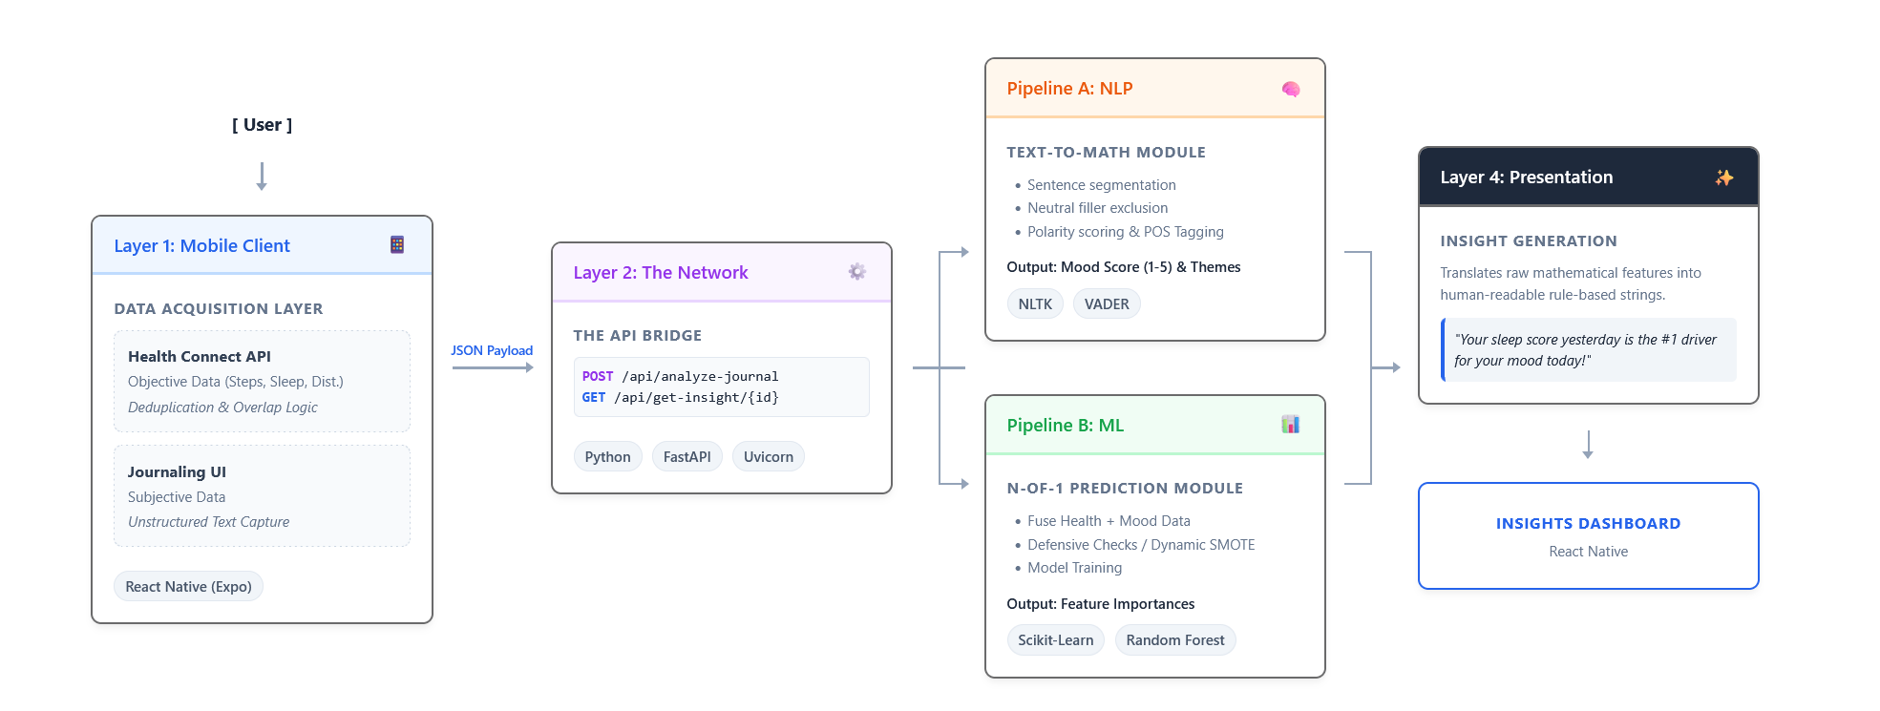
7. SYSTEM ARCHITECTURE

Slide 12
8. DEVELOPMENT & INTEGRATION
Implementation: Client built as a standalone Android APK. Backend hosted locally via FastAPI.
Integration Strategy: Bridged via asynchronous REST API calls (POST /analyze-journal, GET /get-insight) using JSON payloads.
Challenges & Solutions:
Challenge 1 (Sentiment Dilution): Long journal entries with neutral filler words heavily diluted mood scores. Solution: Implemented sentence-by-sentence processing, ignoring neutral sentences to maintain emotional accuracy.
Challenge 2 (Sparse ML Data): Users with less than 7 days of data caused the Random Forest to crash. Solution: Implemented "Defensive Programming" to catch zero-variance and sparse data, returning graceful UI warnings instead of app crashes.

Slide 13
9. PROTOTYPE / RESEARCH FRAMEWORK
Working Prototype: The system is a fully functional, compiled standalone Android application (APK).
It securely reads live physiological data from the device and features a locally hosted Python intelligence layer.
Validation Framework: To prove the n-of-1 ML architecture handles diverse edge-cases, a "Synthetic Validation Suite" (Participants P01 - P16) was engineered to test the backend's response to ideal data, zero-variance data, and sparse data.

Slide 14
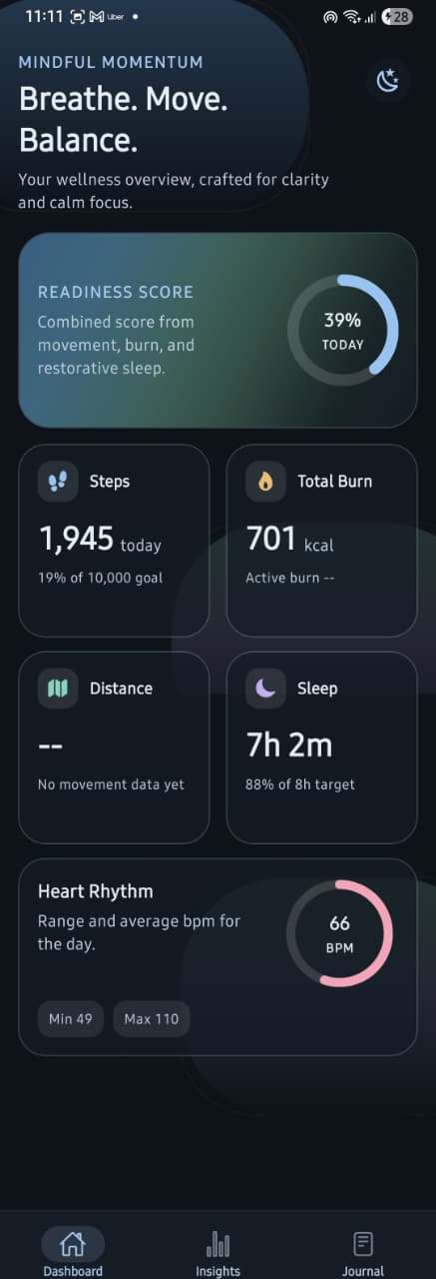
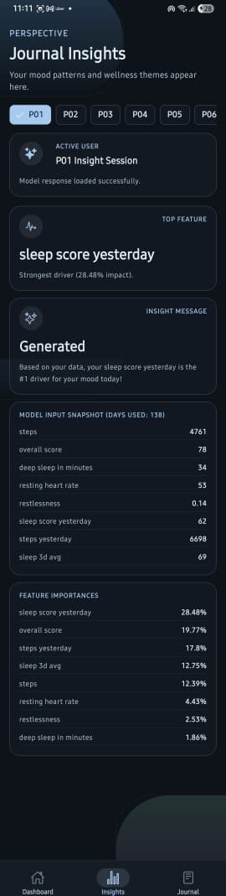
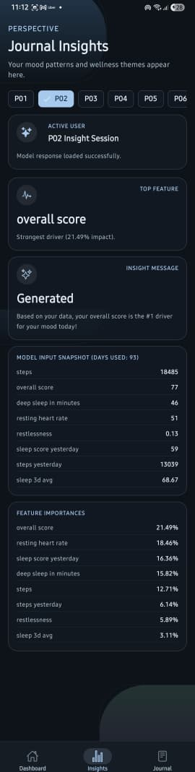
10. OUTCOME

Slide 15
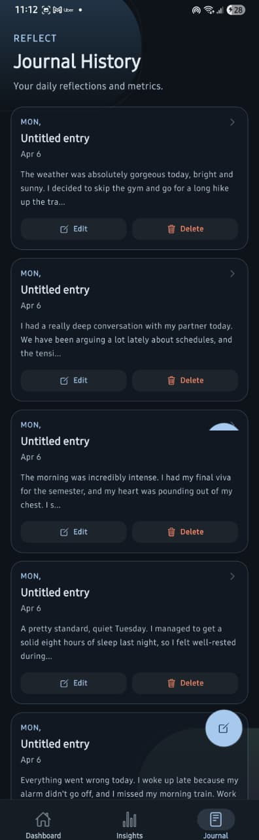
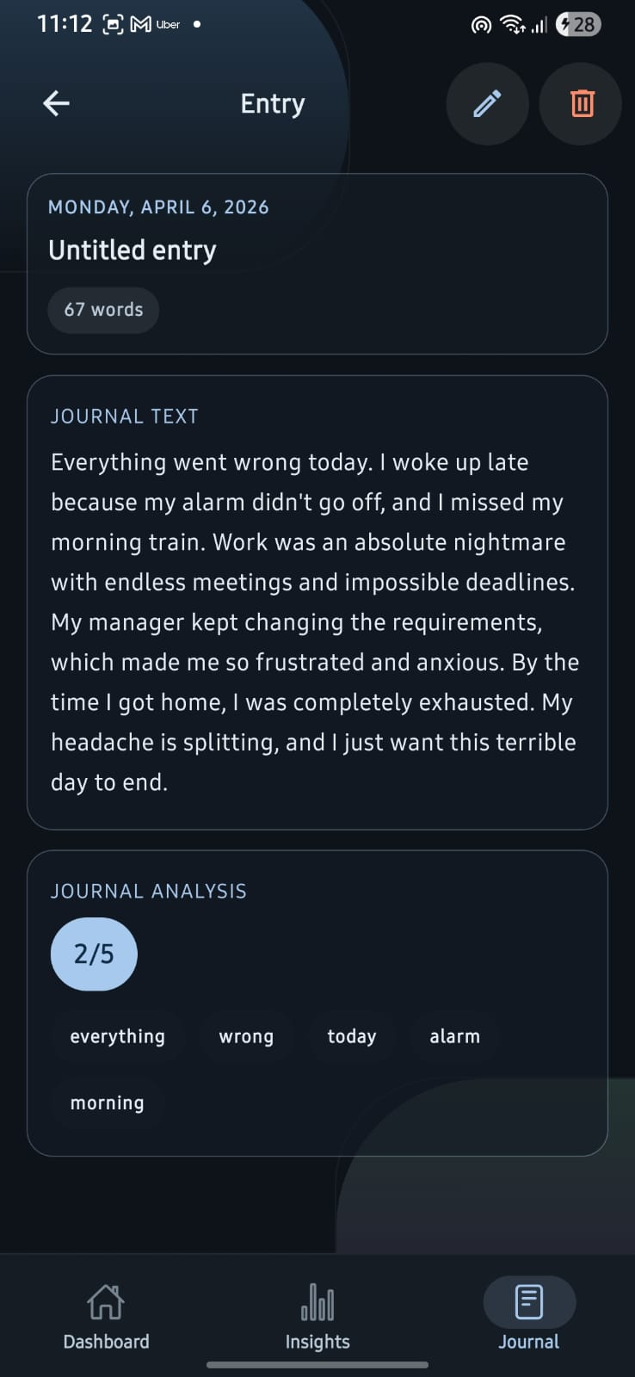
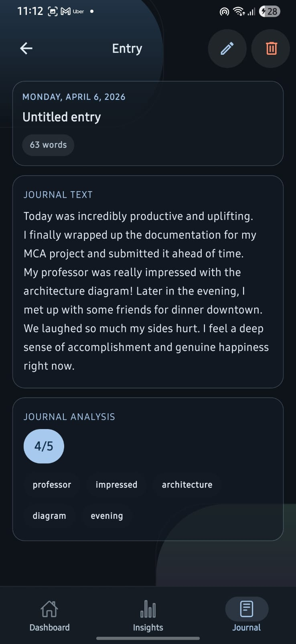
OUTCOME (CONTD..)

Slide 16
11. RESULTS
Performance: The VADER NLP pipeline processes multi-paragraph entries in milliseconds, suitable for real-time mobile UX.
Observations: The Random Forest model successfully isolates primary drivers (e.g., "sleep score yesterday") from noisy tabular data.
Validation: The Defensive Programming architecture successfully caught and handled User P12 (Sparse Data - 1 day logged) and User P03 (Zero Variance), proving the system is robust enough for real-world deployment where user data is often imperfect.

Slide 17
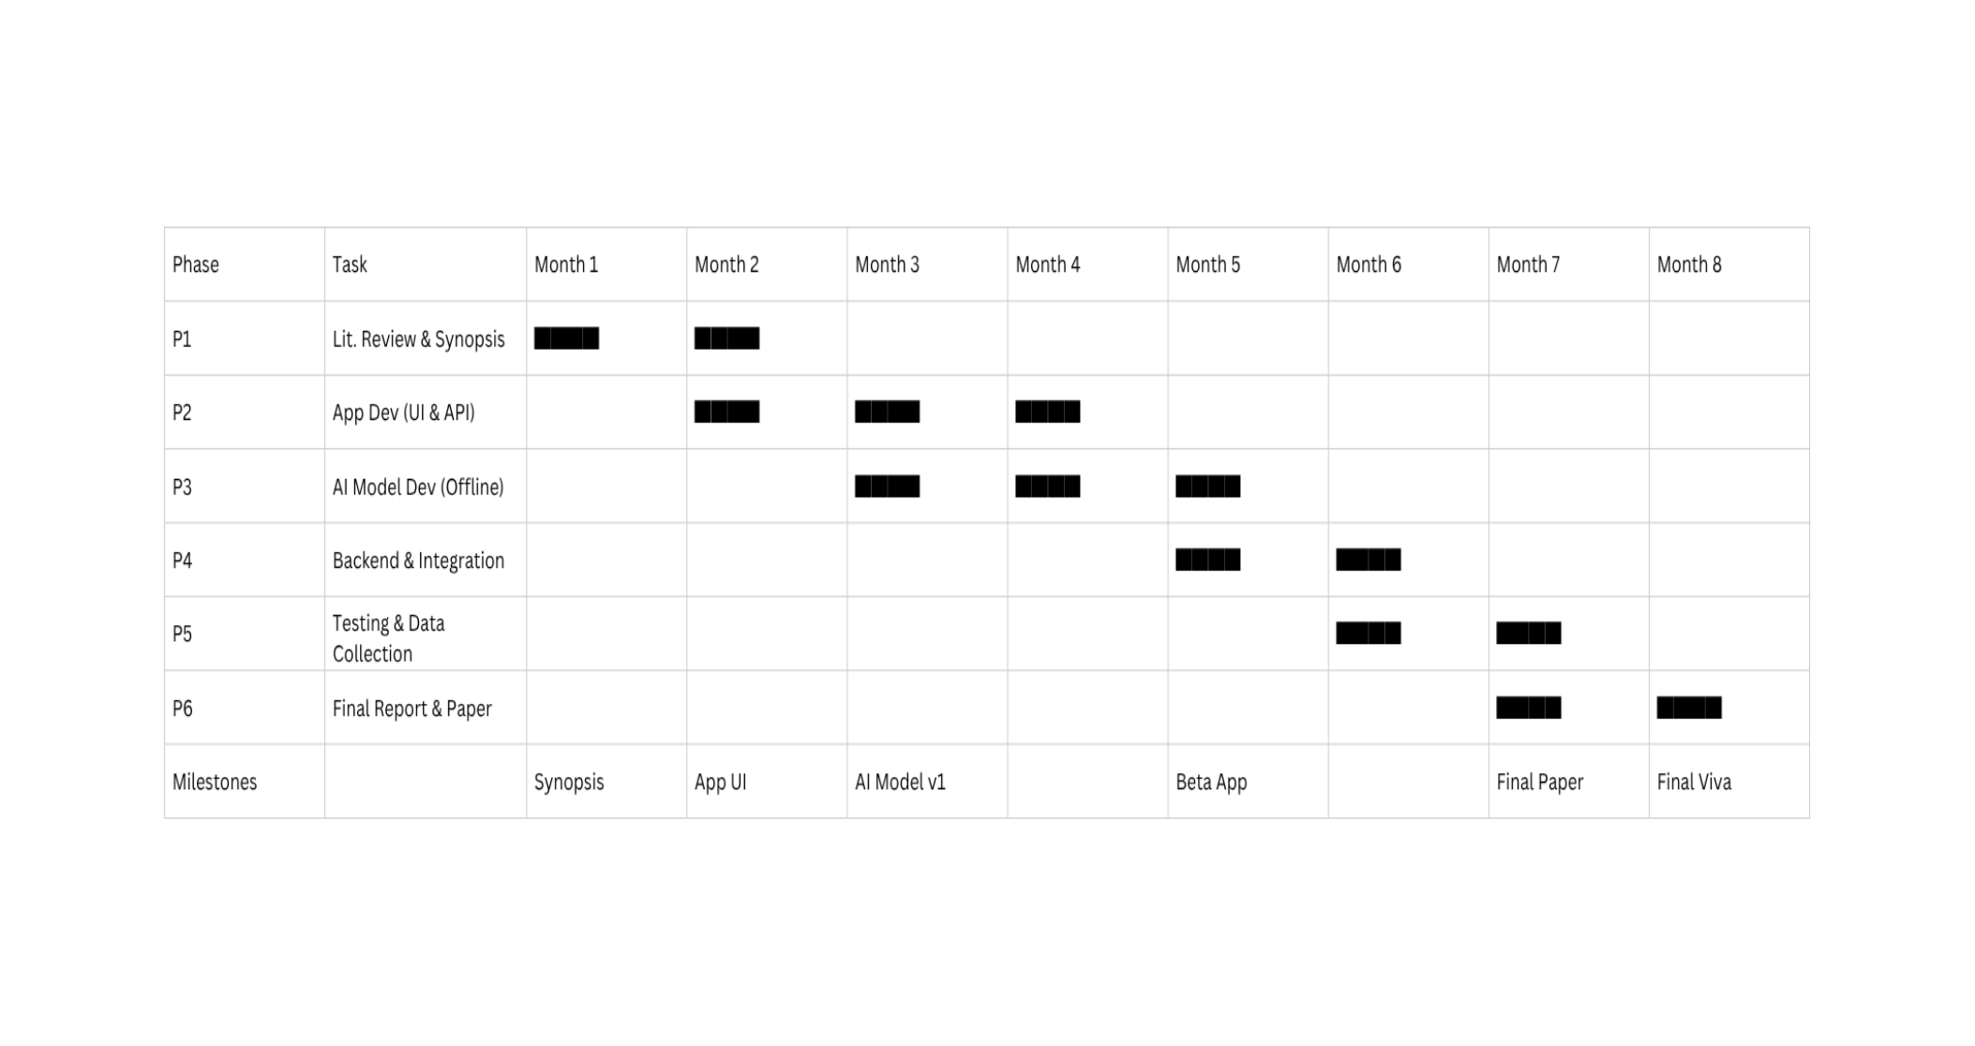
12. TIMELINE / GANTT CHART

Slide 18
REFERENCES
Rabbi, M., et al. (2015). "MyBehavior: A System for Long-Term Personalized Health Coaching." Proceedings of the ACM International Joint Conference on Pervasive and Ubiquitous Computing (UbiComp '15).
Hutto, C. J., & Gilbert, E. (2014). "VADER: A Parsimonious Rule-based Model for Sentiment Analysis of Social Media Text." Proceedings of the Eighth International AAAI Conference on Weblogs and Social Media (ICWSM '14).
M. C., et al. (2019). "n-of-1-path: a path-analysis approach for finding personalized (n-of-1) health effects from time-series data." JMIR Mhealth Uhealth.
C. J., et al. (2024). "Multimodal Machine Learning in Mental Health: A Survey of Data, Algorithms, and Challenges." arXiv preprint arXiv:2407.16804.
Alghowinem, S., et al. (2018). "A Multi-Modal Approach to Depression Detection using Speech, Activity, and Text." Proceedings of the International Conference on Multimodal Interaction (ICMI '18).
Wang, R., et al. (2014). "StudentLife: Assessing Mental Health, Academic Performance and Behavioral Trends of College Students using Smartphones." Proceedings of the ACM International Joint Conference on Pervasive and Ubiquitous Computing (UbiComp '14).
C. A. G., et al. (2025). "Understanding User Perceptions of Personalized Feedback in Digital Health Tools." ResearchGate.
B., R. S., et al. (2025). "EMO Diary: Daily Diary with Sentiment Analysis." International Journal of Scientific Research and Engineering Trends (IJSRET).
Krafft, P. M., & El-Nasr, M. S. (2018). "Journaling for mental health: A review of the benefits and the role of technology." ResearchGate.
He, L., et al. (2020). "Wearable sensors for monitoring mental health: A systematic review." IEEE Transactions on Biomedical Engineering

Slide 19
REFERENCES (CONTD..,)
React Native & Expo: Expo. (2026). Expo Documentation: The framework for universal React Native apps. Retrieved from https://docs.expo.dev/
Android Health Connect API: Google Developers. (2026). Health Connect guide. Android Developers. Retrieved from https://developer.android.com/health-and-fitness/guides/health-connect
FastAPI Backend: Ramírez, S. (2026). FastAPI: High performance, easy to learn, fast to code, ready for production. Retrieved from https://fastapi.tiangolo.com/
Scikit-Learn (Random Forest): Pedregosa, F., et al. (2011). "Scikit-learn: Machine Learning in Python." Journal of Machine Learning Research, 12, 2825-2830.
NLTK (Natural Language Toolkit): Bird, S., Klein, E., & Loper, E. (2009). Natural Language Processing with Python. O'Reilly Media Inc.

Slide 20
Thank You

